Slide 1


IUBAT-International University of Business Agriculture and Technology
Topic
Career Guidance Recommendation System using Machine Learning
SUPERVISOR
Ehsan Ahmed Niloy
Lecturer
Dept. of CSE, IUBAT
Presented By
Name | ID
Md Shahriair Alam | 20103204
Md. Abdul Hakim | 20103281

Slide 2
Table of Content
Problem Statement
Objectives
Motivation
Literature Review
Literature Review Cont.
Research Methodology
Conclusion

Slide 3
Problem Statement
Find better career path after Intermediate and Graduation.
Lack of counselling method of career guidance.
Students take wrong decision for their career because the lacking of appropriate guidance.
Students have knowledge and skills but can’t take proper decision.
This issues can be resolved with high accuracy by machine learning approach.

Slide 4
Objectives
To know about the concept of Career Guidance.
To know about the main Needs of Career Guidance.
To elicited the Importance of Career Guidance at the school and
Graduation level.
To discuss of Career Guidance for choosing best career path.
To some suggesting point-out for improving Career Guidance

Slide 5


Motivation
Students in Bangladesh are extremely hesitating for career selection and what career is best suited for them.
Career counseling organizations are costly and they do not always focus on student’s own interest.
In our research
we will use machine learning algorithms to solve the career related confusions for a student .
An automatic career guidance can help a student to choose their best career field based on his/her skills and performance.

Slide 6
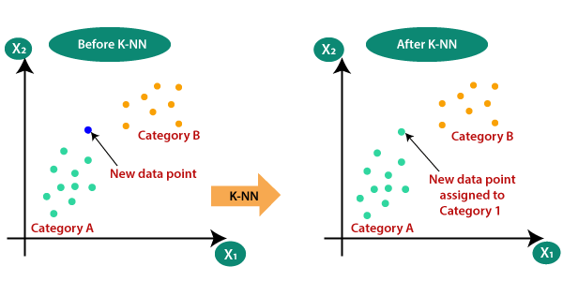
Literature Review-1
Title | An Intelligent Career Guidance System using Machine Learning. Authors : S, Shivani Priyanka C, Shree Manju H, Mythili K Published in: 2021 7th International Conference on Advanced Computing & Communication Systems (ICACCS)
Method | Author used K-Nearest Neighbors Algorithm ( KNN) and Naive Bayes algorithm for the find out better accuracy of career prediction.
Result | The KNN algorithm did work well and defined the correctness of results up to 94% of accuracy.
Limitations | KNN algoithoms not able to handle a large number of categorical departments.

Slide 7
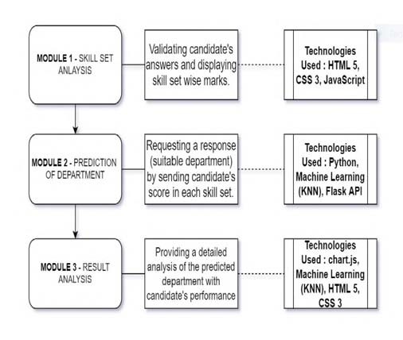
Literature Review-1 Cont.
Fig: Working Phase of the system

Slide 8
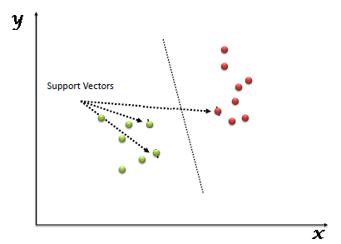
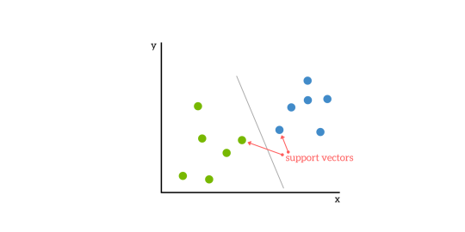
Literature Review-2
Title | Student Career Prediction Using Advanced Machine Learning Techniques. Author: K. Sripath Roy , K.Roopkanth , V.Uday Teja ,V.Bhavana, J.Priyanka Published in: April , 2018
Method | Support vector Machine ( SVM ), Decision tree and XGBoost Machine learning algorithms.
Result | Out of all algorithms SVM gave more accuracy with 90.3 percent.
Future work | A more powerful web application can be developed where inputs are not given directly instead student parameters are taken by evaluating students through various evaluations and examining. Technical, analytical, logical, memory based, and general awareness, interests and skill based tests can be designed and parameters are collected through them.

Slide 9
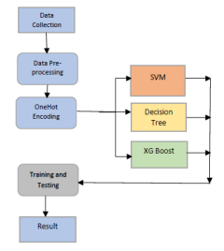
Literature Review-2 Cont.
Fig: Process flow diagram of the system

Slide 10
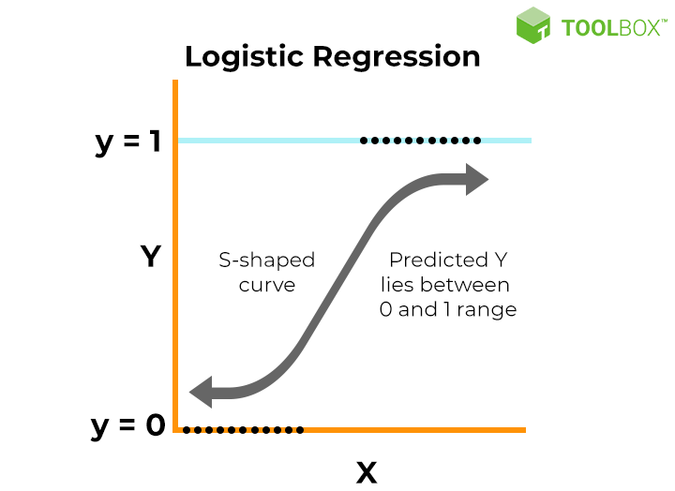
Literature Review-3
Title | Career Guidance using Machine Learning Authors: Shubham Metha, Sarvesh Kamble , Dr. Suhasini Vijay Kumar Published in: June, 2021
Method | Author used Logistics Regression, Naive Bayes, and Support vector Machine ( SVM ) algorithm.
Result | Logistics Regression algorithm gives 93.3% accurate result.
Future work | Only for those who completed SSC and need to counselling for HSC. Further academic areas were not are not covered.

Slide 11
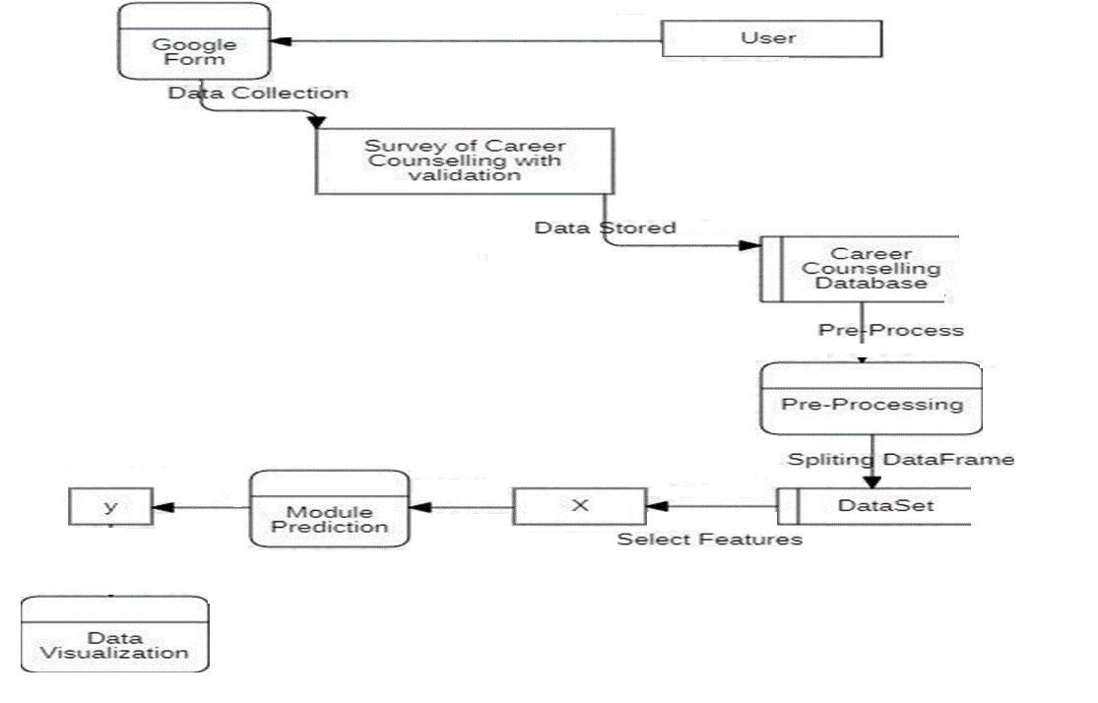
Literature Review-3 Cont.
Filling Survey Form
Fig: Working Phase of the system

Slide 12
Comparison
 | Paper-1 | Paper-2 | Paper-3
Methodologies | K-Nearest Neighbors Algorithm ( KNN) and Naive Bayes algorithm | Support vector Machine ( SVM ), Decision tree and XGBoost Machine learning algorithms. | Logistics Regression, Naive Bayes, and Support vector Machine ( SVM ) algorithm.
Accuracy | KNN - 94% | SVM - 90.3% | Logistic Regression-93.3%
Limitations/ Future Work | Can’t handle large number of data set | Input were taken directly. | Further academic areas were not are not covered.

Slide 13
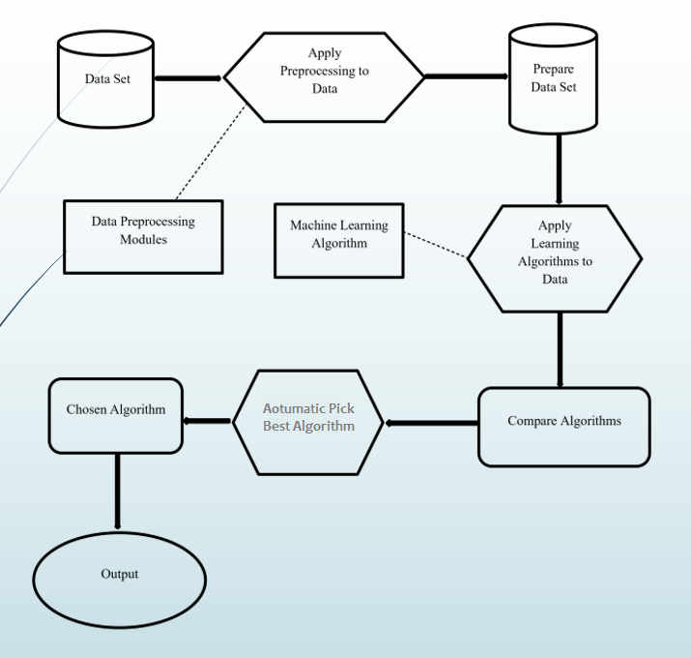
Proposed Methodology
Algorithms
K-Nearest Neighbors Algorithm ( KNN)
Support vector Machine ( SVM )
Confusion Matrix
Content and collaborative filtering.

Slide 14
Conclusion
Students always fail to choose their field of study according to their own interest and choices.
This research can help students to choose their field of study and
it can also help further to get a job in future with his own interest.
By doing so, not only the students will be benefited from this but also our country and the industries
who will assign these pupil in work will be benefited as well.

Slide 15


Slide 16


